Slide 1


Spring boot REST Validation Example
Postman client
SpringBootDemo
DB
Consuming a RESTful Web Services by using Postman client
REST Endpoints to Create/Update/
Get/Delete book details

Slide 2
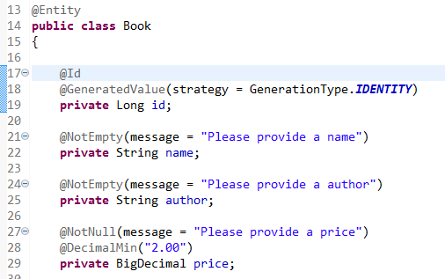
Spring boot REST Validation Example
The bean validation will be enabled automatically if any JSR-303 implementation (like Hibernate Validator) is available on the classpath. By default, Spring Boot will get and download the Hibernate Validator automatically.
Annotate the bean with javax.validation.constraints.* annotations.
1

Slide 3
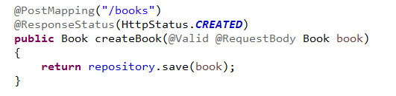
Spring boot REST Validation Example
Add @Valid to @RequestBody. - bean validation is enabled now.
2

Slide 4
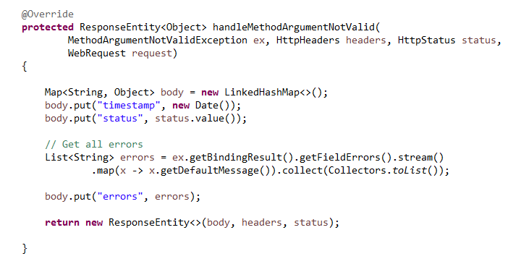
Spring boot REST Validation Example
3
Catch the MethodArgumentNotValidException and override the response like this

